Slide 1


Presentation of the Synthesis Project
National Engineering School of Tunis
University of Tunis El Manar
Civil Engineering Department
Development and study of a complete interchange
Chiheb BEN DAHSEN
Fares FRIKHA
Mariem HAJJI
Année universitaire 2020-2021
3 Year Civil Engineering 2

Slide 2
LAYOUT
Introduction
Bibliographic study
Traffic study and layout propositions
Pavement dimensioning
Modeling the bridge using “SAP2000”
Conclusion

Slide 3
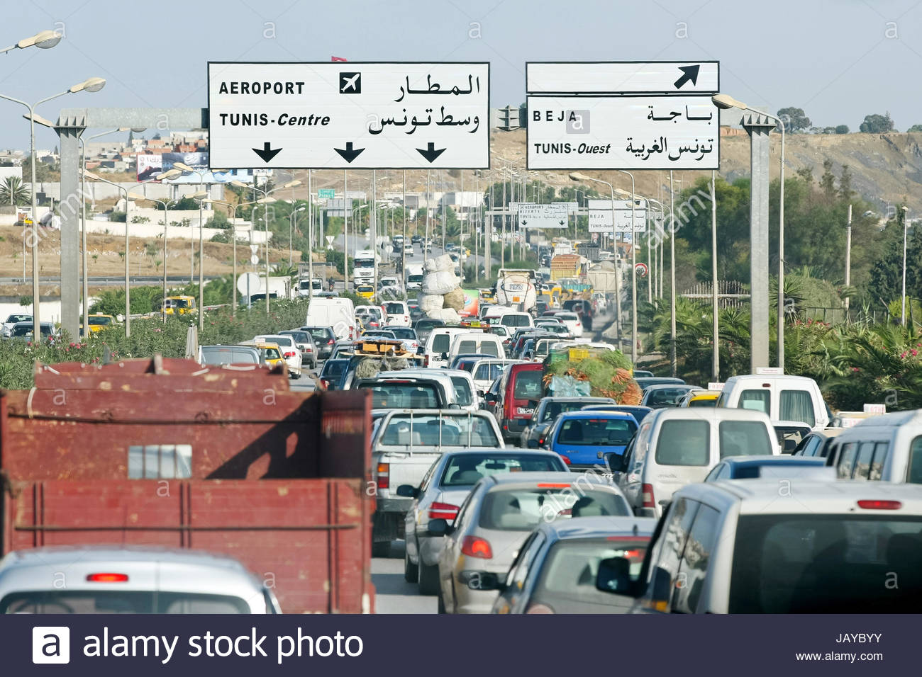
INTRODUCTION
In order the minimize the traffic jam in Tunis, we have to make:
An Interchange

Slide 4
BIBLIOGRAPHIC STUDY
Definitions
Types of interchanges

Slide 5
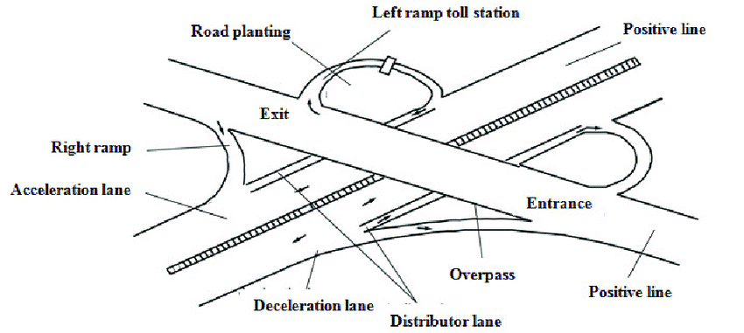
Definition
An interchange is a road junction that uses grade separation and typically one or more ramps to permit traffic on at least one highway to pass through the junction without interruption from other crossing traffic streams.

Slide 6

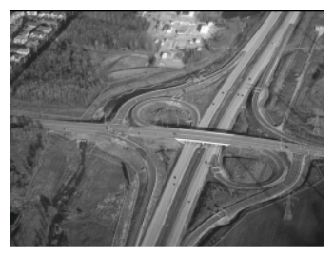

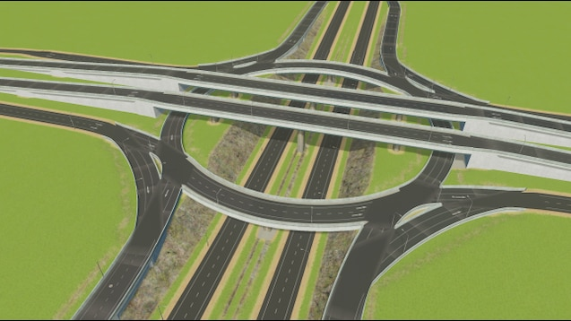
Types of interchanges
Service Interchanges
Partial Cloverleaf interchange
Cloverleaf Interchange
Diamond Interchange
Roundabout Interchange

Slide 7


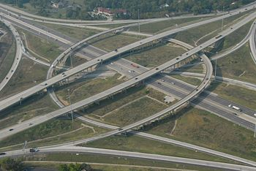
Types of interchanges
System Interchanges
Directional Interchange
Cloverstack Interchanges
Turbine Interchange

Slide 8
TRAFFIC STUDY AND LAYOUT PROPOSITIONS
Traffic data
Justification of the layout
Design stages
Layout prepositions

Slide 9
Traffic data
01
Project’s commission year : 2022
02
Lifetime : 20 years.
03
Annual growth rate : 3%.
04
Width of a track : 3,5 m.

Slide 10
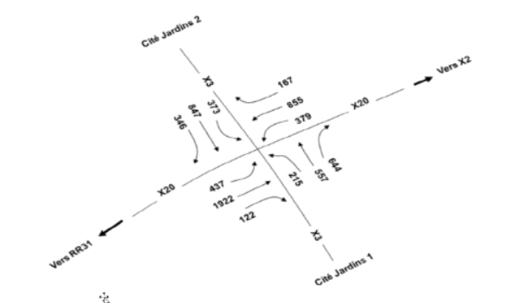
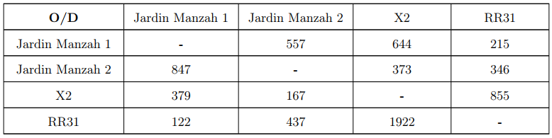
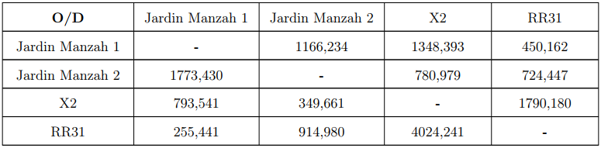
Traffic data
2017
2042

Slide 11
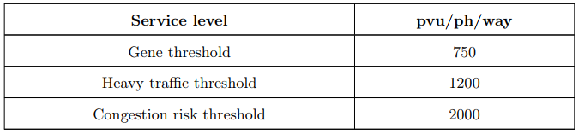
Justification of the layout
Daily p.v.u traffic in commissioning year 2022
The maximum average daily traffic in terms of heavy goods vehicles in 2017 : T2017 = 1922 pvu/peak hour
The maximum average daily traffic in terms of heavy goods vehicles in 2022 : T2022 = 2229 pvu/peak hour
Daily p.v.u traffic at end of service year 2042
Determination of the number of lanes
2x3 lanes for X20 and X3
1 lane for suspenders and curls

Slide 12
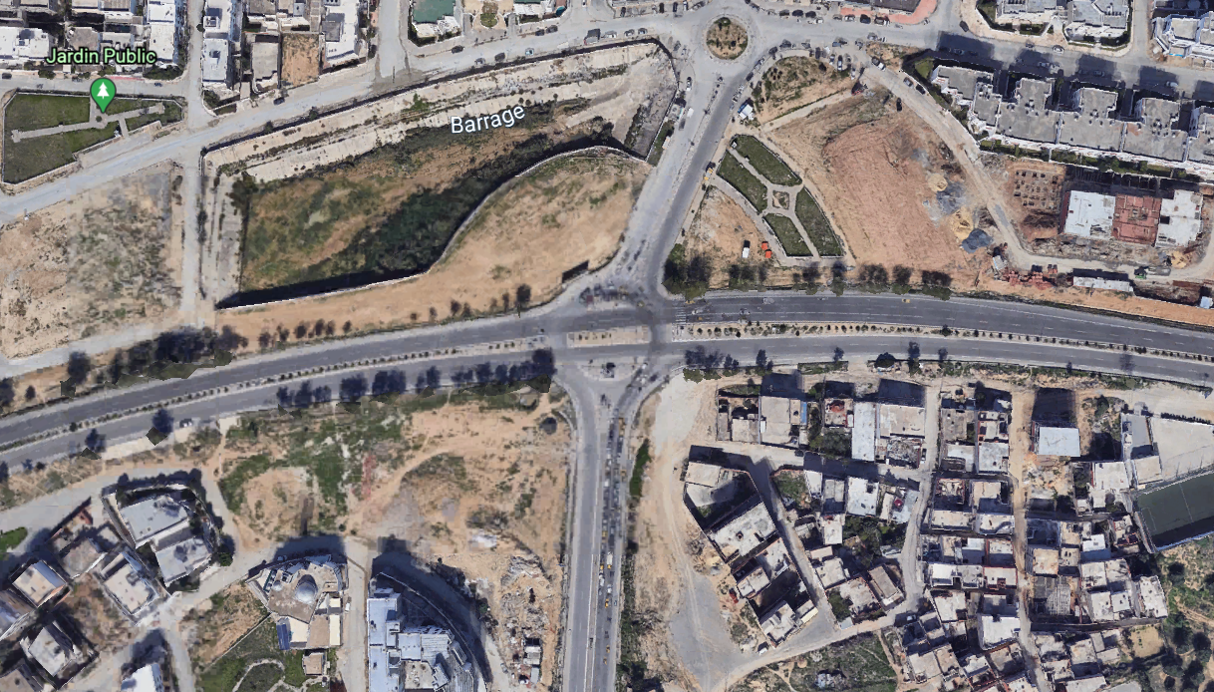
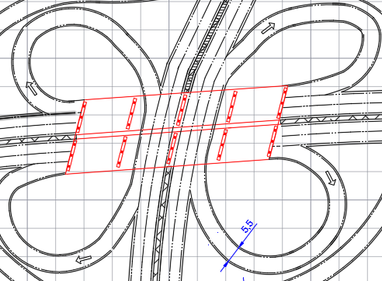
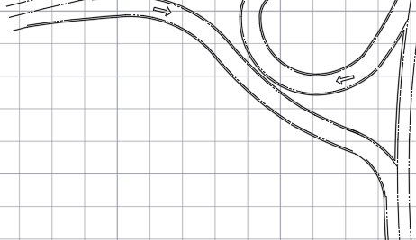
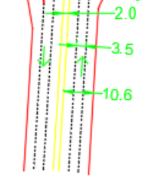
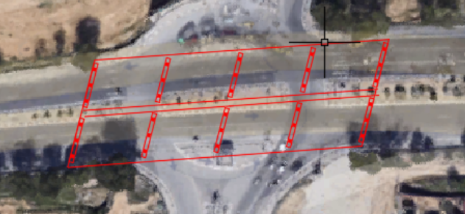
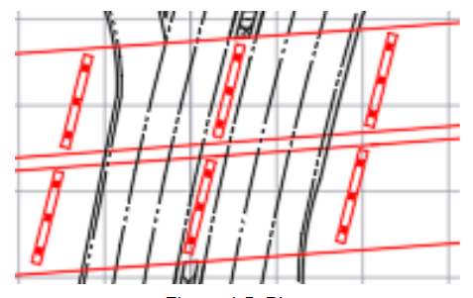
Design stages
Importing crossroads from Google Earth
Drawing the bridges
Drawing the roads X20 and X3
Drawing the piers, abutments and bearings
Drawing curls
Drawing the suspenders

Slide 13
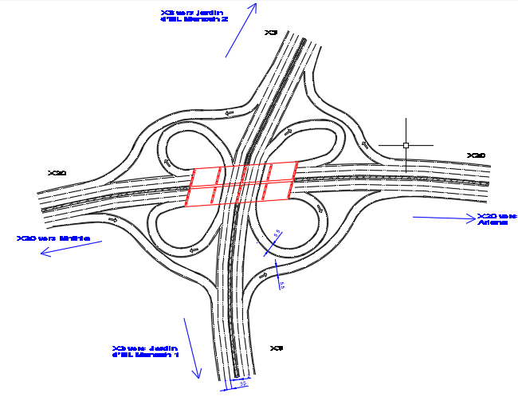
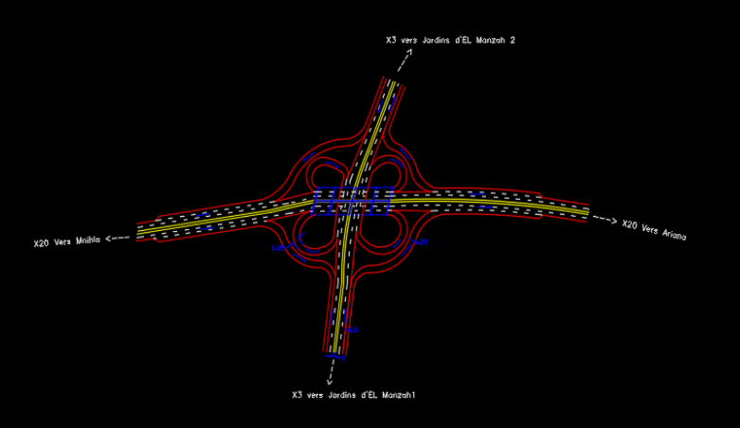
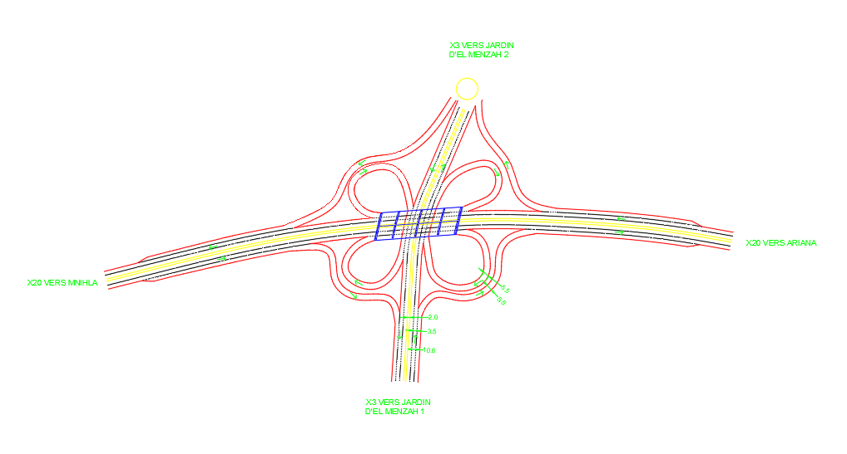
Layout propositions
Layout proposed by Mariem
Layout proposed by Chiheb
Layout proposed by Fares

Slide 14
PAVEMENT DIMENSIONING
Dimensioning in heavy goods vehicles
Geotechnical studies
Dimensioning with ALIZE

Slide 15
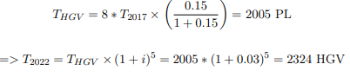
Dimensioning in heavy goods vehicles
Tph(pvu) = 2 x HGV + LV
Tc = 365 x Tm x Aeq x β
Daily heavy traffic calculation | T2017 = 1922 pvu/peak hour
 | Percentage of heavy goods vehicles : 15%
 | The average daily traffic = 8 x Traffic in peak hour
Cumulative traffic | Tc = 365 x T2022 x 0.5 x 0.9 = 7, 1.10^6 axle of 13 T
We have : Tc > 4 millions so we will determine the traffic class by ”ALIZE”

Slide 16
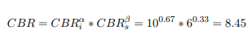
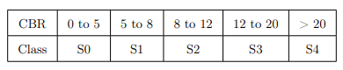
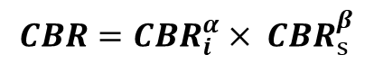
Geotechnical studies
$$CBR={CBR}_{i }^{α}× {CBR}_{s }^{β}$$
α = 0,67 et β = 0,33
Localisation de our project: zone B
Soil’s class S2

Slide 17

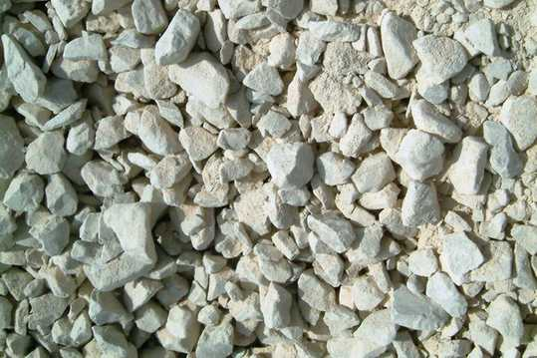

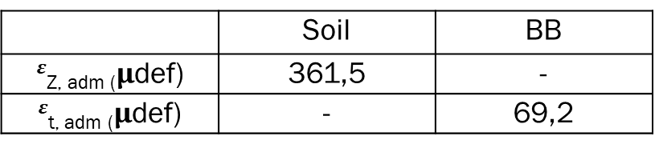
Geotechnical studies
Calculation of allowable limits
The admissible vertical deformation of the soil:
$${ ε}_{ z,adm}=A×{\left(NE\right)}^{−α}$$
6 cm
❶
22 cm
❷
The admissible horizontal deformation of the BB:
30 cm
❸
20 cm
4
 | Soil | BB
$ε$_{Z, adm (}$μ$def) | 361,5 | -
$ε$_{t, adm (}$μ$def) | - | 69,2
5

Slide 18
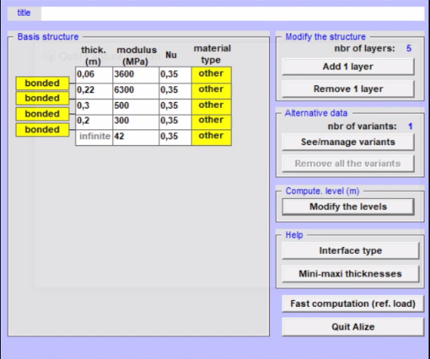
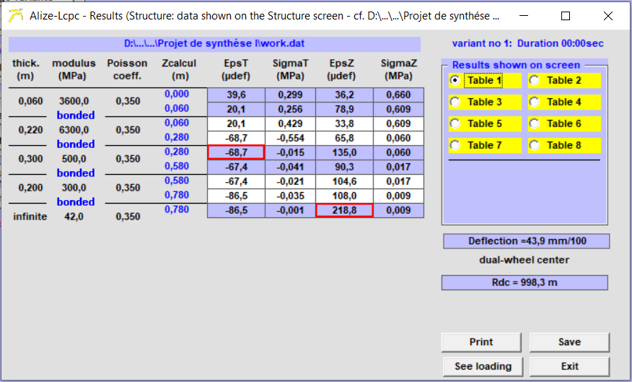
Dimensioning with ALIZE

Slide 19
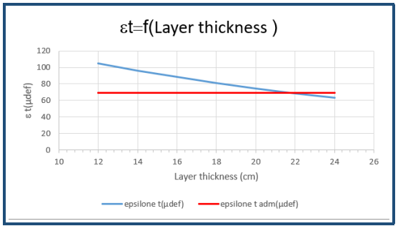
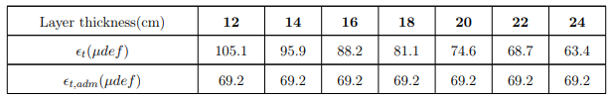
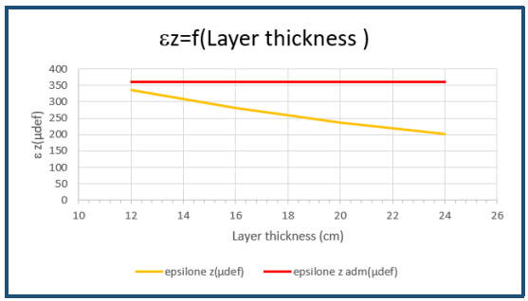
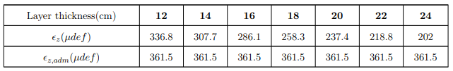
Dimensioning with ALIZE

Slide 20
MODELING THE BRIDGE USING “SAP2000”
Data entry
Dynamic study
Studying the bridge under load "Al"

Slide 21
Data entry
Defining the workspace
Drawing the shell
Defining the materials
Assigning the section to the shell
Calculating by finite element method
Locating the bearings

Slide 22
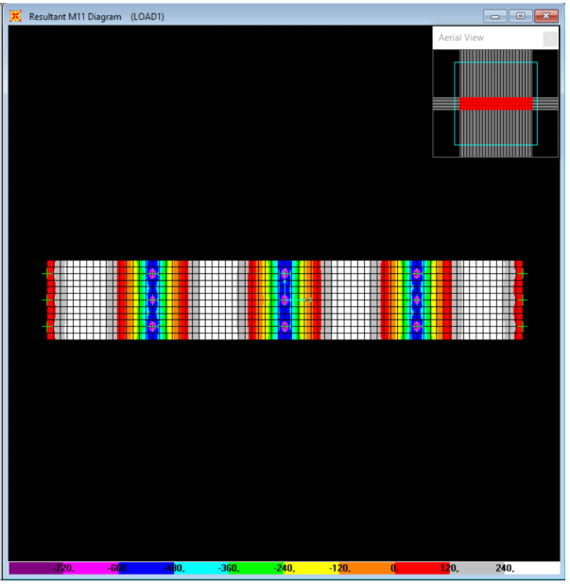
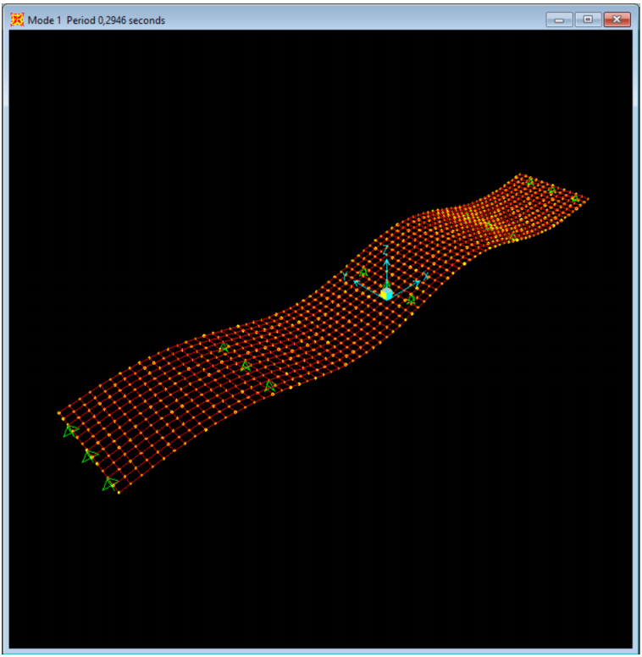
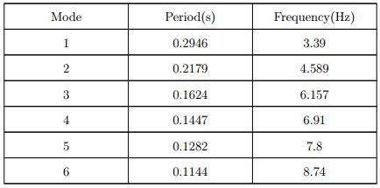
Dynamic study
Dynamic study of the structure up to the 6th clean modes.
Displaying loads under the self-weight in "SAP2000“.
Frequencies obtained:

Slide 23
Dynamic study
Parameters that influence the natural frequency of the structure
Constant load
Temporary dynamic load
Other temporary loads
Solutions :
Give the deck an inverted airplane wing profile so that, in windy conditions, it exerts a downward force instead of lifting and falling.
Surround the cables with a profiled sheath in order to limit their drag.
The use of shock absorbers which absorb the energy caused by the earthquake.

Slide 24
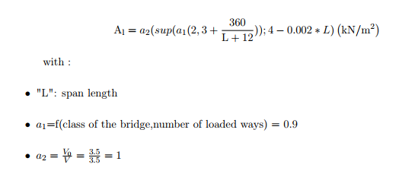
Studying the bridge under load "Al"

Slide 25
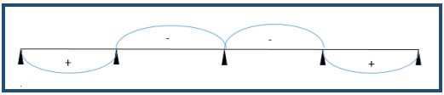
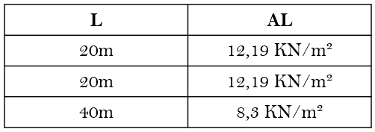
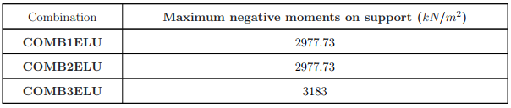
Studying the bridge under load "Al"
Moment on central support

Slide 26
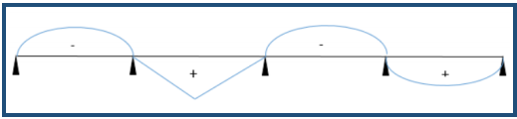
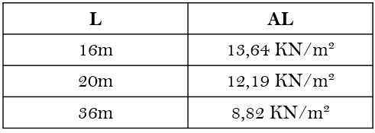
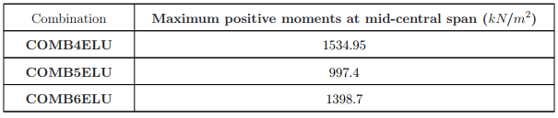
Studying the bridge under load "Al"
Moment at mid-central span

Slide 27
Conclusion
Designing the interchange using “AutoCAD”.
A traffic and a geotechnical studies enabled us to size the roadway with "ALIZE".
Modeling the slab bridge by finite element method using “SAP2000”.

Slide 28
Thank you for your attention

